Slide 1
Prediction of Patients in Intensive Care Units for Emilia-Romagna Region
Statistical Methods for Data Science
DSSC
A.A. 2021 - 2022
Behrooz Nooshin - Bonaiuto Bruno - De Nardin Carlo - Moustafa Fatma

Slide 2
Data Exploration Analysis

Slide 3
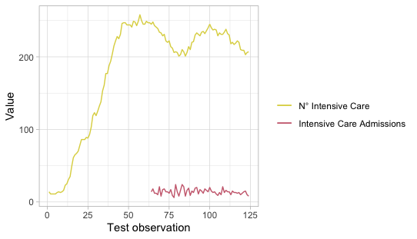
First look at the variables
Missing variables: we decided to discard the intensive care admission since it presents 64 NA values on 124 total values of the dataset. We are not able to compute the previous values for this variable.
New covariants: we added the color of the region as a new covariant. Since the color of the region is a parameter that was added on the 7th of november we decided to fill the 36 NA values with the color white since there were not restriction.

Slide 4
Correlation
To perform the analysis between the response variables and the covariants two indexes were used:
Pearson (r): correlation coefficients that can assume a value between -1 and 1. The further and r value is from zero, the stronger the relationship between the two variables. The sign of r indicates the nature of the relationship: positive or negative;
Coefficient of determination (r²): represent the percentage of variation of the Y variable that can be attributed to the variation in X. Higher correlation means a larger portion of the variance that can be explained by the independent variables.

Slide 5
Correlation table
Variables | r | r²
Total patients hospitalized | 0.97 | 0.942
Patients hospitalized | 0.965 | 0.932
Positive | 0.953 | 0.909
Home confinement | 0.952 | 0.906
Total people tested | 0.818 | 0.670
New positive | 0.772 | 0.597
Tests performed | 0.765 | 0.585
Total cases | 0.739 | 0.547
Death | 0.590 | 0.348
Recovered | 0.503 | 0.253
Color | - 0.375 | 0.141
Positive variation | 0.095 | 0.009

Slide 6
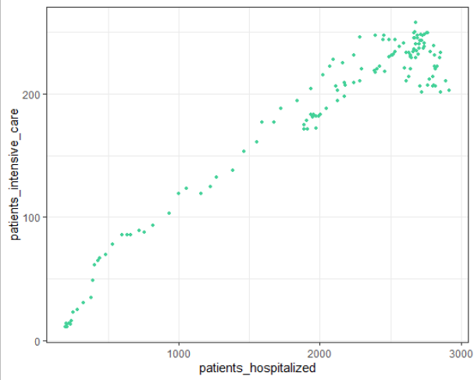
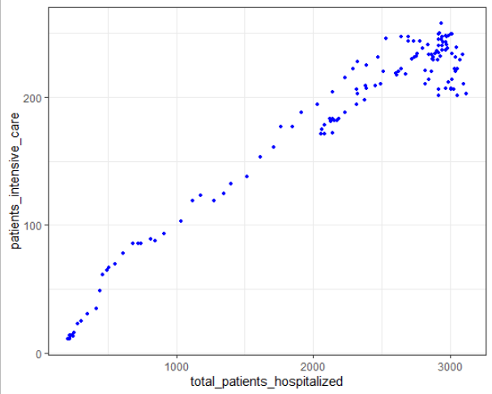
Multi-correlation
By plotting the covariants against the response variable we noticed that many variables shows high correlation among them. This will affect the models by causing high VIF, collinearity or concurvity.
As an example, the patients hospitalized and total patients hospitalized are highly correlated as shown in the following scatter plots.
The independence of variables should be examined when fitting the different models.

Slide 7
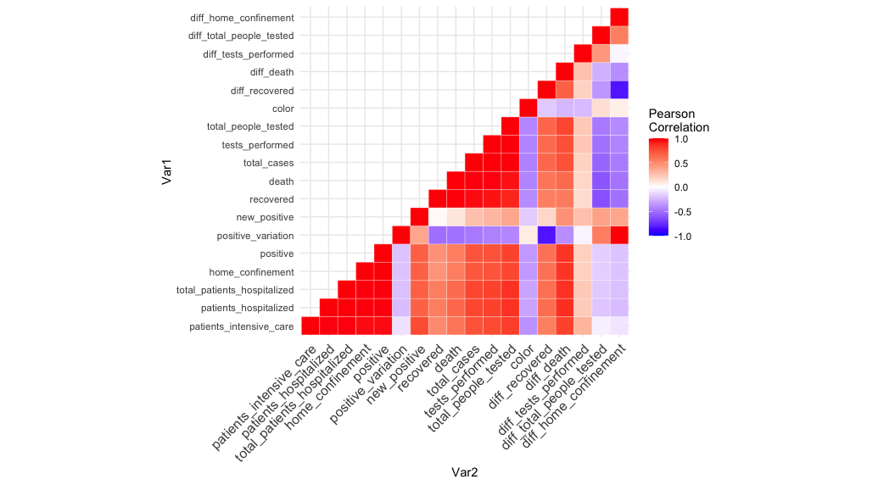
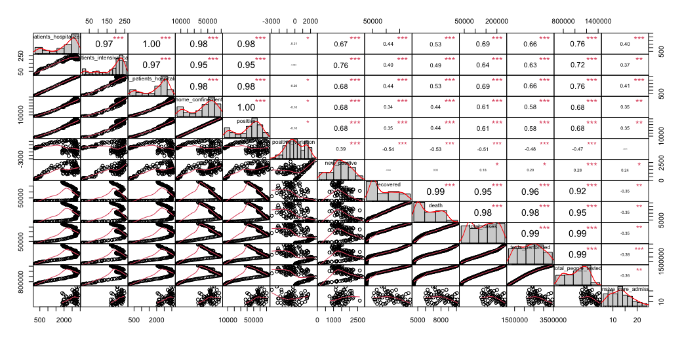
Multi-correlation
We decided to examine the multi-correlation factor by using a heat-map plot between all the variables.

Slide 8
Time Series Analysis
Since we are doing a prediction of the response over time, this problem could be treated as a time series problem.
We decided to not use the time series analysis, since we do not have enough data over the time. So we did not consider dates when solving our problem.
Our prediction of the response variable was based only on the covariates related to the illness and patients statistics.

Slide 9
Linear Regression
Model

Slide 10
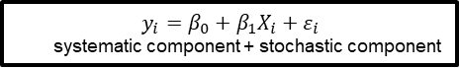
The Aim of the Regression Modelling
Interpretation:
Which covariates (x_{i}) affect more the response variable (y)? How these covariates affect the response variable?
Prediction:
This models can provide a prediction of response variable which is a phenomenon of interest.

Slide 11
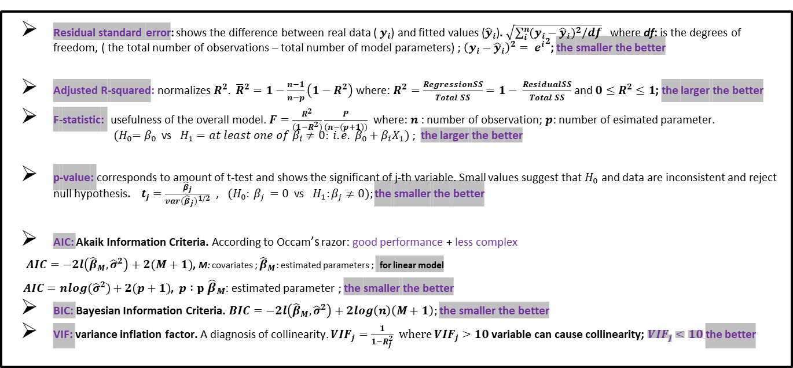
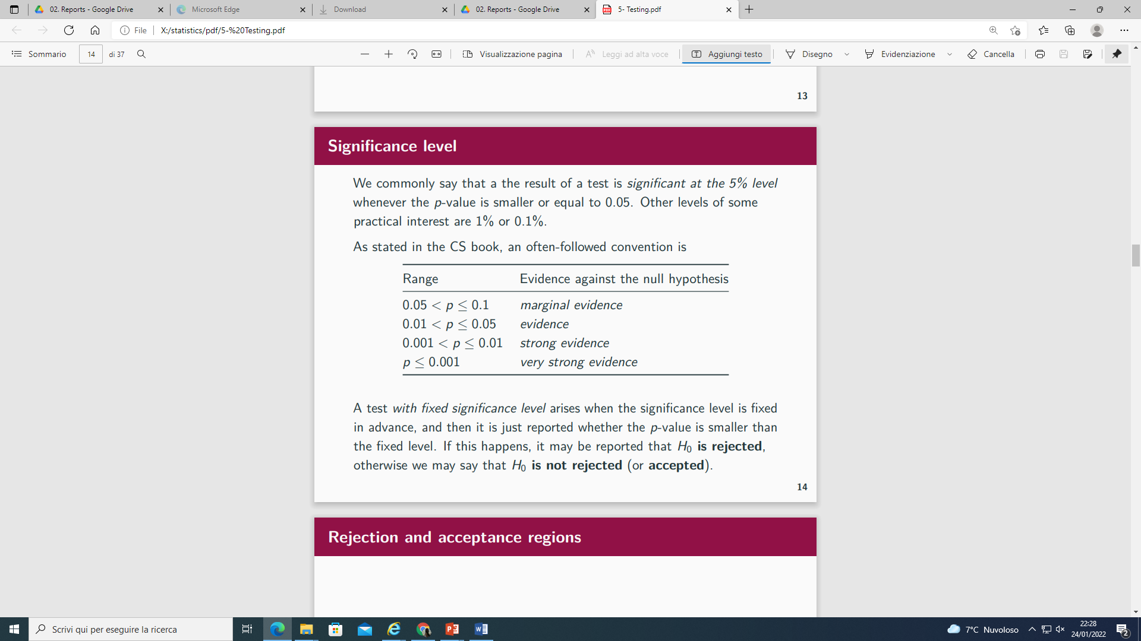
Model selection

Slide 12
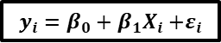
1. Linear regression models based on pearson variable selection and FW method
Variable Importance ( x ) | Pearson Correlation | Adjusted R-squared
1. patients_hospitalized | 0.97 | 0.9322
2. total_patients_hospitalized | 0.97 | 0.9419
3. home_confinement | 0.95 | 0.9062
4. positive | 0.95 | 0.9092
5. new_positive | 0.76 | 0.5941
6. total_people_tested | 0.72 | 0.6675
7. total_cases | 0.64 | 0.5439
8. tests_performed | 0.63 | 0.5818
9. death | 0.49 | 0.3435
10. recovered | 0.40 | 0.2471
11. color | -0.375 | 0.006336
12. positive_variation | -0.9 | 0.001045
response variable =
patients_intensive_care

Slide 13
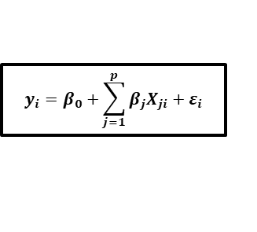
1. The best multiple linear regression models based on pearson variable selection and FW method
Variables x | Residual standard error | Adjusted R-squared | F-statistic | p-value | AIC | BIC | VIF
1.patients_hospitalized + new_positive + total_people_tested | 15 on 120 df | 0.9629 | 1066 on 3 and 120 DF | < 2.2e-16 | 675.4506 | 679.9926 | patients_hospitalized new_positive total_people_tested 8.6944 2.6421 5.4756
2.patients_hospitalized + new_positive + recovered | 15.39 on 120 df | 0.9610 | 1010 on 3 and 120 DF | < 2.2e-16 | 681.5231 | 686.0651 | patients_hospitalized new_positive recovered 4.0756 2.8082 2.1975
3.patients_hospitalized + new_positive + death | 15.37 on 120 df | 0.9611 | 1014 on 3 and 120 DF | < 2.2e-16 | 681.8961 | 686.4381 | patients_hospitalized new_positive death 4.8074 2.8360 2.6218
Selected variables x
patients_hospitalized
new_positive
recovered
death
total_people_tested

Slide 14
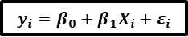
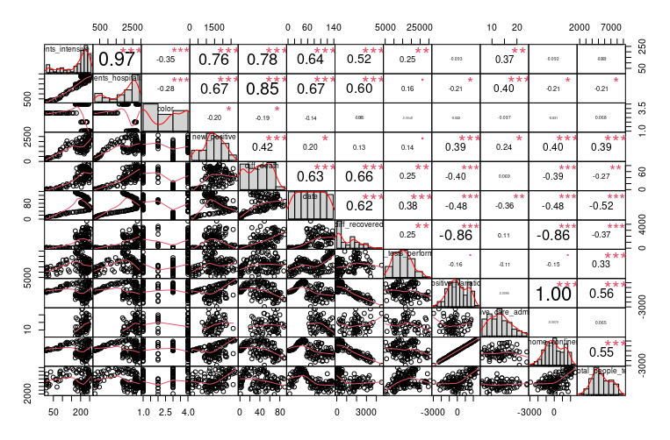
2. Linear regression models based on MRMR variable selection and FW method (Maximum Relevance – Minimum Redundancy)
Variables x | Pearson Correlation | Adjusted R-squared
1.patients_hospitalized | 0.97 | 0.9322
2. color | -0.35 | 0.1342
3. new_positive | 0.76 | 0.5941
4. diff_death | 0.78 | 0.6353
5. date | 0.64 | 0.5673
6. diff_recovered | 0.52 | 0.2892
7. intensive_care_admission | 0.37 | 0.006336
8. diff_tests_performed | 0.25 | 0.08471
9. positive_variation | -0.093 | 0.001045
10. diff_home_confinement | -0.092 | 0.001265
11. diff_total_people_tested | -0.069 | -0.003051
response variable =
patients_intensive_care

Slide 15
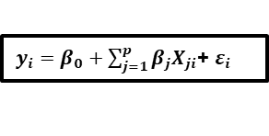
2. The best multiple linear regression models based on MRMR variables selection and FW method
Variables x | Residual standard error | Adjusted R-squared | F-statistic | p-value | AIC | BIC | VIF
1. patients_hospitalized + color + new_positive | 14.32 on 120 df | 0.9662 | 1173 on 3 and 120 DF | < 2.2e-16 | 664.0209 | 668.5628 | patients_hospitalized color new_positive 1.9945 1.1061 1.8615
2. patients_hospitalized + color + new_positive + diff_death | 14.37 on 118 df | 0.9649 | 839.5 on 4 and 118 DF | < 2.2e-16 | 660.5696 | 666.2471 | patients_hospitalized color new_positive diff_death 6.6046 1.1096 2.0343 4.4450
3. patients_hospitalized + diff_death + new_positive | 16.10 on 119 df | 0.9559 | 883.3 on 3 and 119 DF | < 2.2e-16 | 687.5873 | 692.1293 | patients_hospitalized diff_death new_positive 6.3327 4.4221 2.0226
Selected variables x
patients_hospitalized
color
new_positive
diff_death

Slide 16

3. The best multiple linear regression models based on previous results and FW method
Variables x | Residual standard error | Adjusted R-squared | F-statistic | p-value | AIC | BIC | VIF
1. patients_hospitalized + new_positive + recovered + color | 14.14 on 119 df | 0.9670 | 903.3 on 4 and 119 DF | < 2.2e-16 | 661.8754 | 667.5529 | patients_hospitalized new_positive recovered color 4.0878 2.8704 2.4486 1.2325
2. patients_hospitalized + new_positive + death + color | 14.17 on 119 df | 0.9669 | 899 on 4 and 119 DF | < 2.2e-16 | 662.4459 | 668.1234 | patients_hospitalized new_positive death color 4.8745 2.9246 3.0064 1.2684
3. patients_hospitalized + new_positive + recovered + color + positive_variation | 14.2 on 118 df | 0.9668 | 716.9 on 5 and 118 DF | < 2.2e-16 | 663.8255 | 670.6384 | patients_hospitalized new_positive recovered color positive_variation 5.6651 4.9337 2.4729 1.2386 2.3965
Previous results
Residual standard error | Adjusted R-squared | AIC | VIF
From 15, 14.4 to 14 .1 | From 0.961, 0.965 To 0.967 | 670, 680 To 660 | Max 8, 6 to 4,5

Slide 17
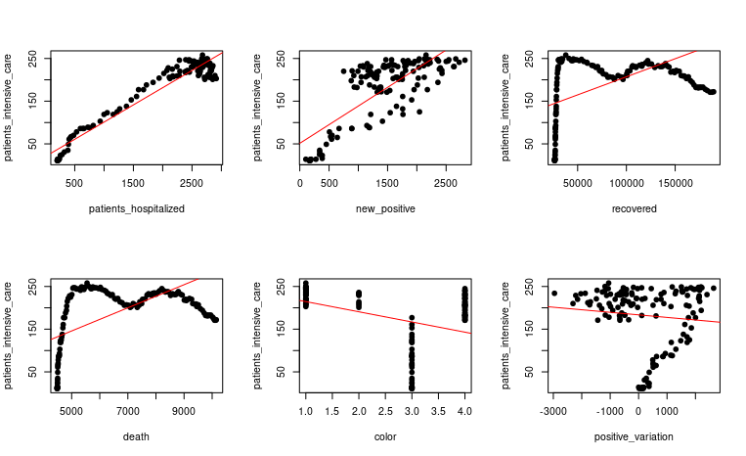
response variable =
patients_intensive_care
Selected variables x
patients_hospitalized
new_positive
recovered
death
color
positive_variation

Slide 18
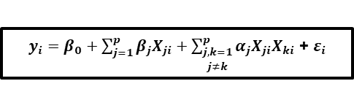
4. The best multiple linear regression models Included interaction terms and FW method
Variables x | Residual standard error | Adjusted R-squared | F-statistic | p-value | AIC | BIC | VIF | RMSE For test_set
1. patients_hospitalized + new_positive + recovered:color + death:recovered | 13.31 on 119 df | 0.9708 | 1024 on 4 and 119 DF | < 2.2e-16 | 662.4459 | 668.1234 | patients_hospitalized new_positive recovered:color recovered:death 3.9614 2.7957 1.4166 1.9440 | 27.74371
2. patients_hospitalized + new_positive + positive_variation:recovered + positive_variation:color + color The best | 13.06 on 118 df | 0.9719 | 851 on 5 and 118 DF | < 2.2e-16 | 663.8255 | 670.6384 | patients_hospitalized new_positive color positive_variation:recovered positive_variation:color 3.6752 3.5630 1.1073 1.9225 2.8558 | 19.22978
Residual standard error | Adjusted R-squared
From 14 to 13 | From 0.96 To 0.97
AIC | VIF
The same | Max 4 To 3

Slide 19
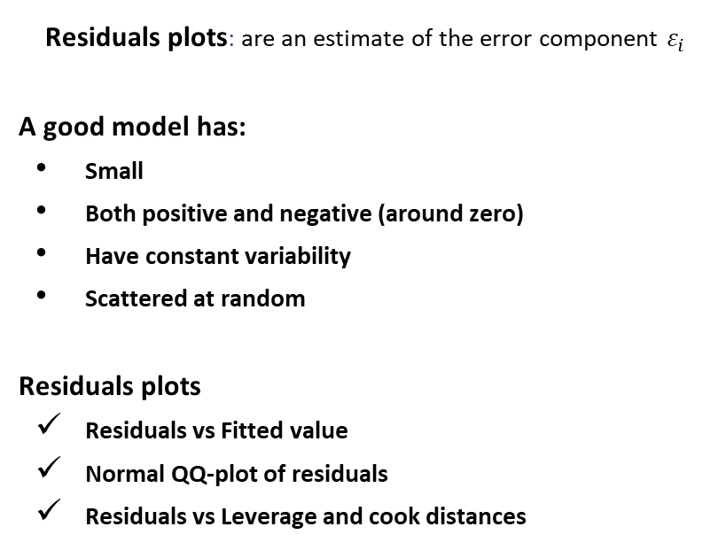
Model checking

Slide 20
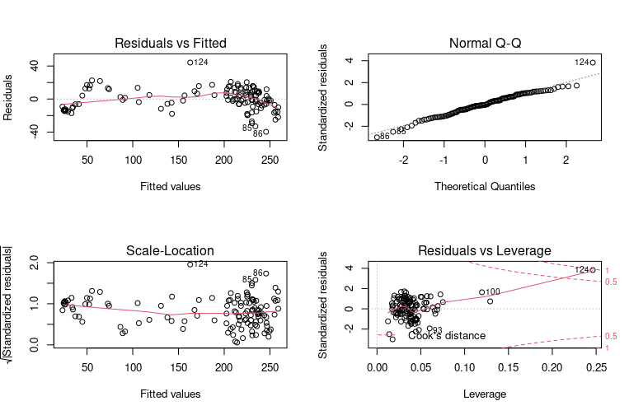
1. Call:
lm(formula = patients_intensive_care ~ patients_hospitalized +
new_positive + recovered:color + death:recovered, data = train_set)
Residuals:
Min 1Q Median 3Q Max
-39.741 -8.121 -0.528 9.250 44.199
Coefficients:
Estimate Std. Error t value Pr(>|t|)
(Intercept) 1.066e+01 3.323e+00 3.207 0.00172 **
patients_hospitalized 6.527e-02 2.557e-03 25.532 < 2e-16 ***
new_positive 2.753e-02 2.911e-03 9.457 3.61e-16 ***
recovered:color -7.788e-05 1.325e-05 -5.879 3.86e-08 ***
recovered:death 2.044e-08 3.655e-09 5.594 1.44e-07 ***
---
Signif. codes: 0 ‘***’ 0.001 ‘**’ 0.01 ‘*’ 0.05 ‘.’ 0.1 ‘ ’ 1
Residual standard error: 13.31 on 119 degrees of freedom
Multiple R-squared: 0.9718, Adjusted R-squared: 0.9708
F-statistic: 1024 on 4 and 119 DF, p-value: < 2.2e-16

Slide 21
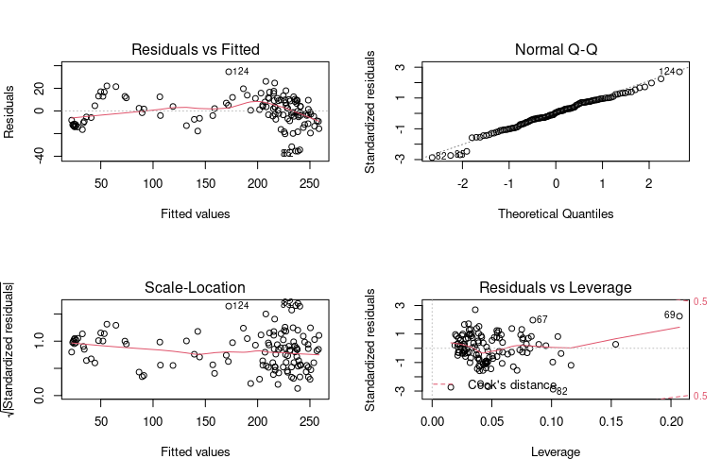
The final best model in linear regression model
2. Call:
lm(formula = patients_intensive_care ~ patients_hospitalized +
new_positive + positive_variation:recovered + positive_variation:color +
color, data = train_set)
Residuals:
Min 1Q Median 3Q Max
-35.547 -8.278 0.578 9.593 34.656
Coefficients:
Estimate Std. Error t value Pr(>|t|)
(Intercept) 2.509e+01 4.397e+00 5.706 8.76e-08 ***
patients_hospitalized 6.937e-02 2.417e-03 28.701 < 2e-16 ***
new_positive 2.031e-02 3.226e-03 6.297 5.39e-09 ***
color -6.443e+00 1.010e+00 -6.382 3.56e-09 ***
positive_variation:recovered -7.397e-08 1.740e-08 -4.251 4.28e-05 ***
positive_variation:color 2.661e-03 5.732e-04 4.642 9.00e-06 ***
---
Signif. codes: 0 ‘***’ 0.001 ‘**’ 0.01 ‘*’ 0.05 ‘.’ 0.1 ‘ ’ 1
Residual standard error: 13.06 on 118 degrees of freedom
Multiple R-squared: 0.973, Adjusted R-squared: 0.9719
F-statistic: 851 on 5 and 118 DF, p-value: < 2.2e-16

Slide 22
Generalized Linear
Model

Slide 23
Introduction to GLM
•The data are independently distributed.
•The dependent variable Yi doesn’t need to be normally distributed.
•A GLM doesn’t assume a linear relationship between the response variable and the explanatory variables.
•Errors need to be independent but not normally distributed.
•Parameter estimation uses maximum likelihood estimation (MLE).

Slide 24
GLM parameters
The link function, the expected value of the response relates to the linear combination of explanatory variable
The Error Structure.
The linear predictor.
The canonical link function, the default options employed when a particular error structure is specified in the family directive in the model formula
The dispersion parameter φ

Slide 25
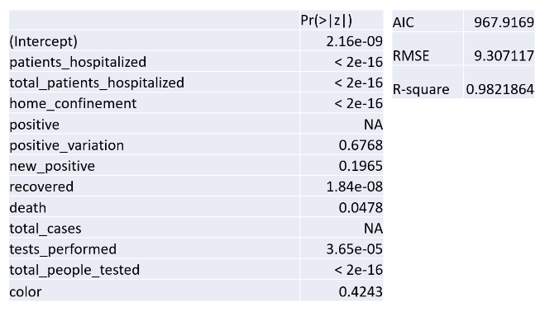
Model 1
glm(patients_intensive_care ~ ., family = poisson, data = train_set)
Output Discussion
•The Root Mean Square Error(RMSE) of predicted values for patients in intensive care for 14 days compared to the actual values is 9.307
•For the next models, we remove the least significant variables.

Slide 26
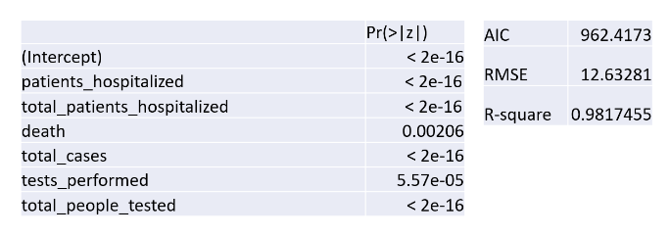
Model 2
glm(patients_intensive_care ~.-recovered-home_confinement-positive-positive_variation-new_positive-color, data=train_data,
family = poisson)
Output Discussion
•The Root Mean Square Error(RMSE) of predicted values for patients in intensive care for 14 days compared to the actual values is 12.63
•For the next model, we are going to use the independent variables

Slide 27
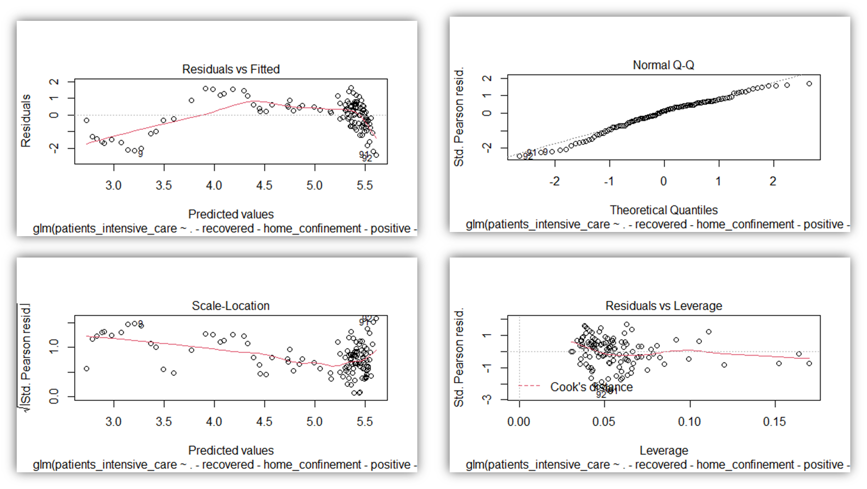
Model 2 - the residuals plots

Slide 28
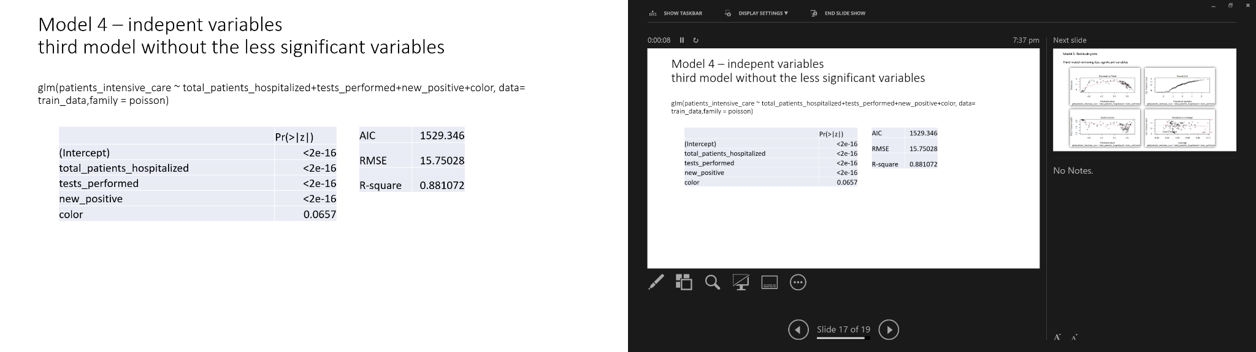
Model 3
glm(patients_intensive_care ~ total_patients_hospitalized+tests_performed+new_positive+color, data= train_data,family = poisson)
Output Discussion
•The Root Mean Square Error(RMSE) of predicted values for patients in intensive care for 14 days compared to the actual values is 15.75
•The data is not normally distributed, AIC is the highest in this model, with the highest RMSE becoming the worst model.

Slide 29
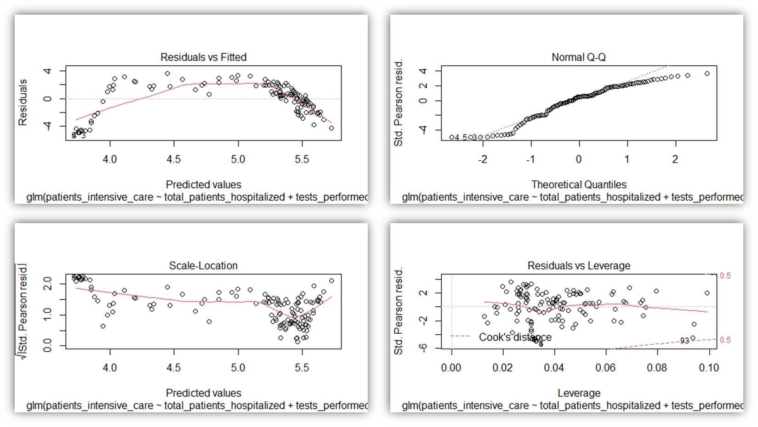
Model 3 - the residuals plots

Slide 30
Generalized Additive Model

Slide 31
Introduction to GAMs
GAMs is the addition of smooth functions of covariates and linear effects.
GAMs provides a tradeoff between the interpretability of linear models or generalized linear models and the flexibility of non parametric complex approaches like Neural networks or trees.
They can easily fit nonlinear functions to get predictions and obtain some inference about the model as well.
Data is fitted using smooth functions(made up from basis functions) or splines to accommodate for the nonlinearity in the relationship between variables.

Slide 32
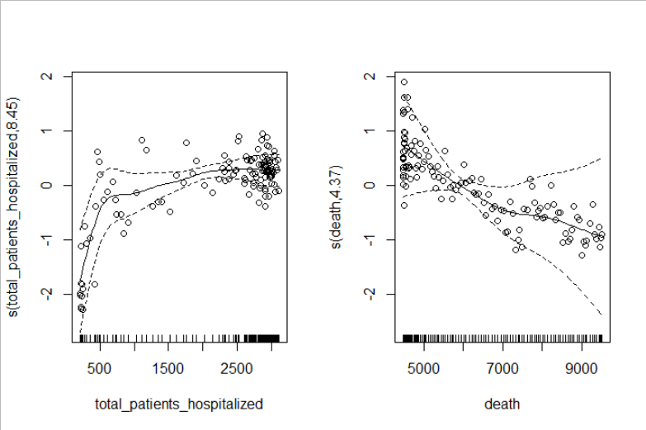
Model 1- Best model(not considering independence between variables)- Partial residuals
variables included: smooths of total_patients_hospitalized and death + linear terms of total_people_tested and tests_performed
AIC=894.4661
R-sq.(adj) = 0.997
RMSE= 9.85764

Slide 33
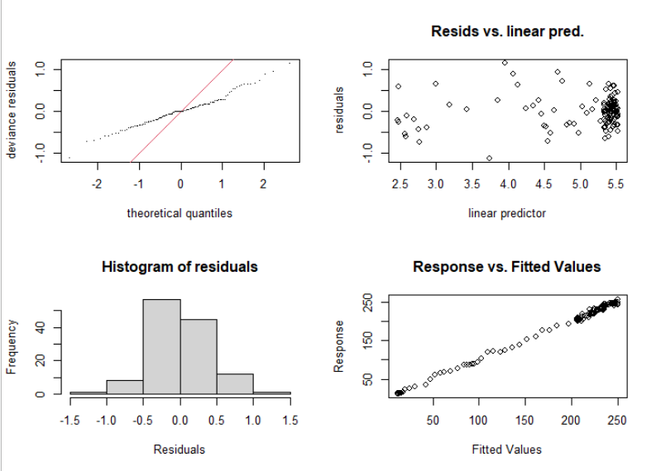
Model 1 – Residual Plots
The QQ plot shows that the deviance residuals and theoretical residuals do not coincide. It is very close to a straight line.
However, we have an almost normal distribution for the residual histogram.
Residuals vs linear predictor shows that there is somehow an evenly distribution around 0
The response over fitted value nearly form a straight line.

Slide 34
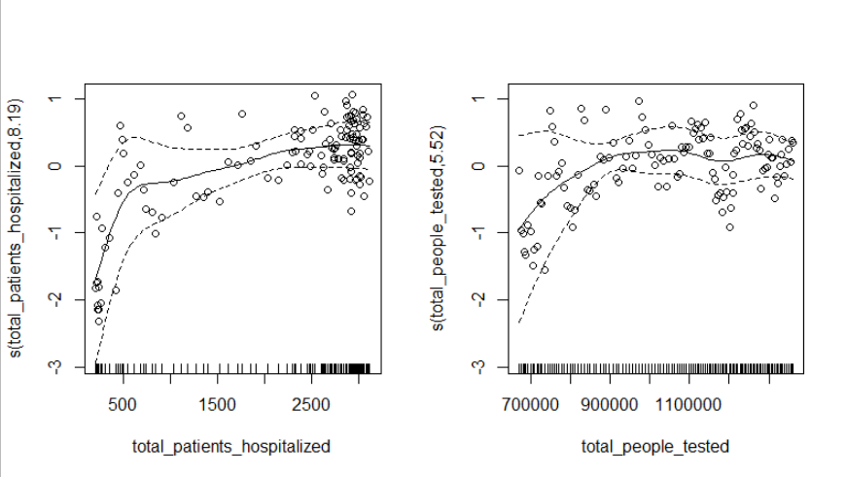
Model 2- Best Model considering only independent variables
variables included: smooths of total_patients_hospitalized and total_people_tested
AIC=899.7196
R-sq.(adj) = 0.995
RMSE = 3.73646199

Slide 35
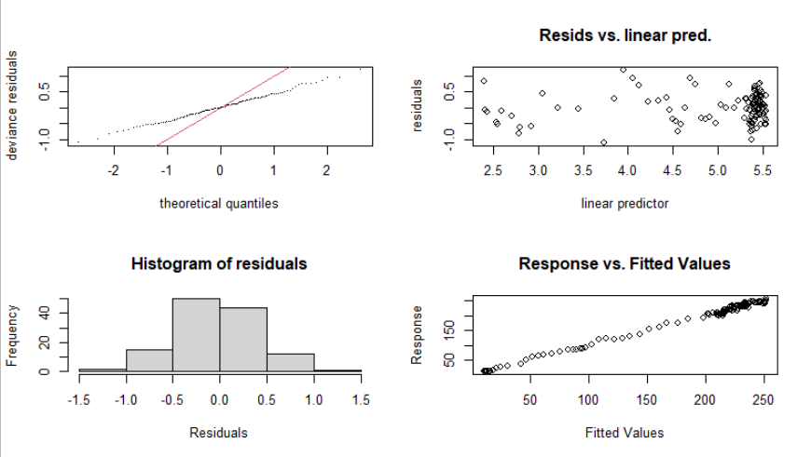
Model 2 – Residual Plots
The overall residuals show very little improvement compared to the previous model.
Although the AIC doesn’t decrease, the overall residual plots are better, lower adj. R-squared and the root mean square error is one third of the previous model.

Slide 36
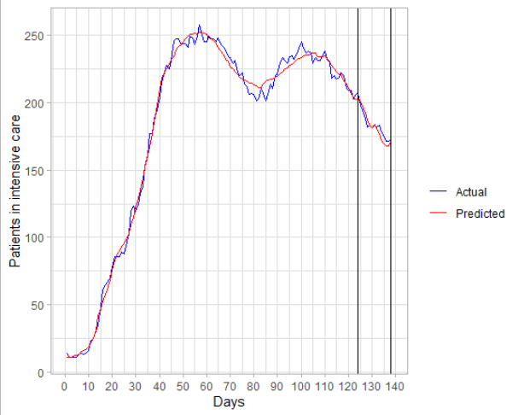
Actual vs. predicted for the best model

Slide 37
Trees and ensemble methods

Slide 38
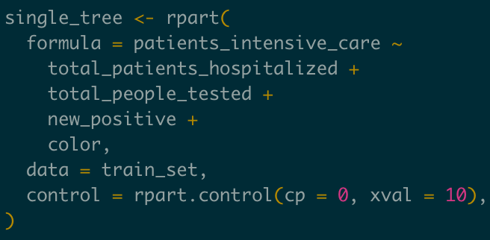
Regression Tree
Different single tree models were fitted to obtain the best regression tree. Four covariates were used to fit the best model:
Total patients hospitalized
Total people tested
New positive
Color
At the beginning the model was trained with the complexity parameter setted at 0 and the xval at 10.

Slide 39
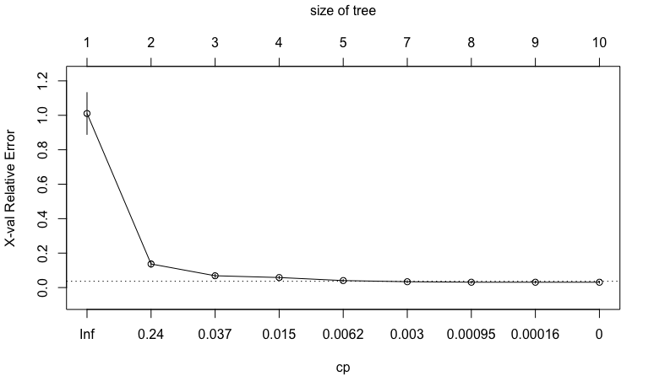
Regression Tree
Then the xerror in the complexity table was analyzed to find a possible cp value that could be used to prune the tree.
A cp of 0.0213 was selected to perform the tree pruning operation.

Slide 40
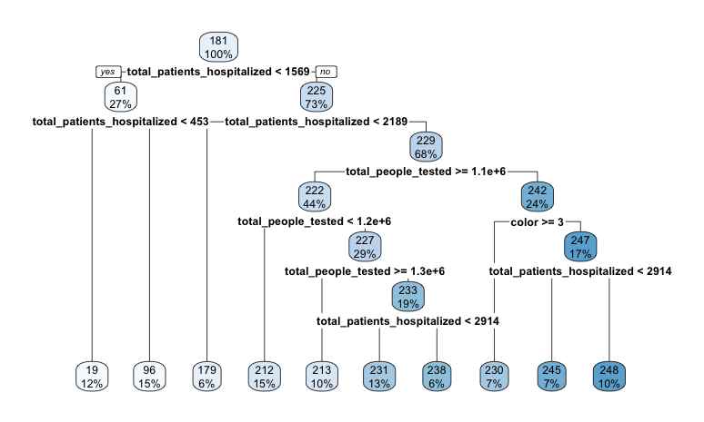
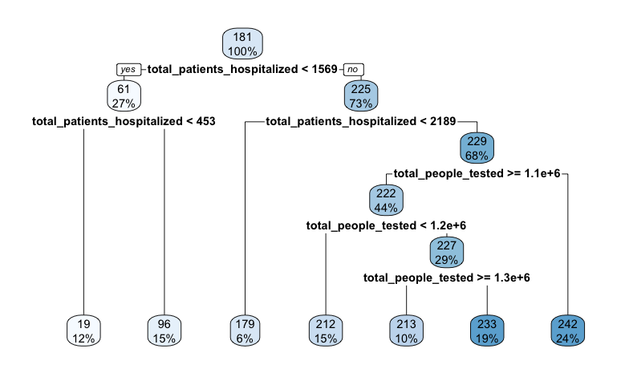
Regression Tree
By reducing the complexity of the tree it has been shown that the new positive and the color variables were not so useful so it was kept the pruned tree to perform the prediction phase.

Slide 41
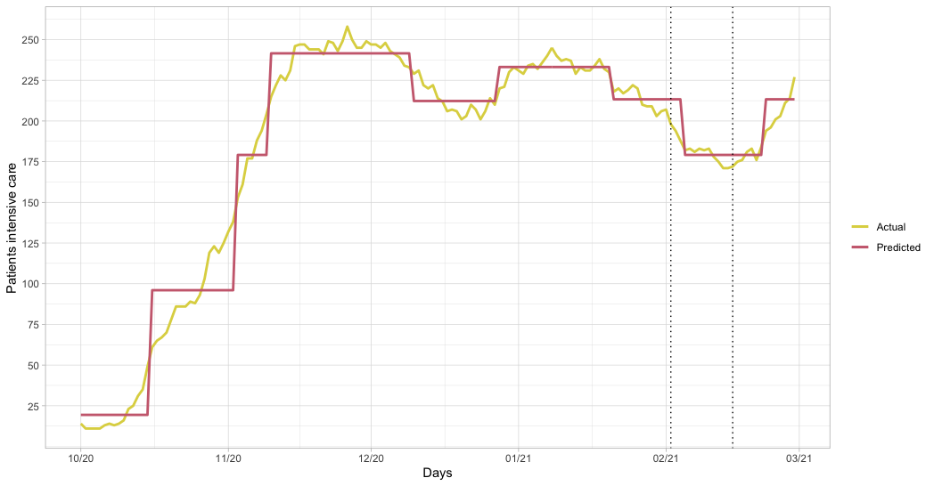
Regression Tree
The prediction and the results were computed for the first 15 days of February. The trend then was analyzed for the whole month.

Slide 42
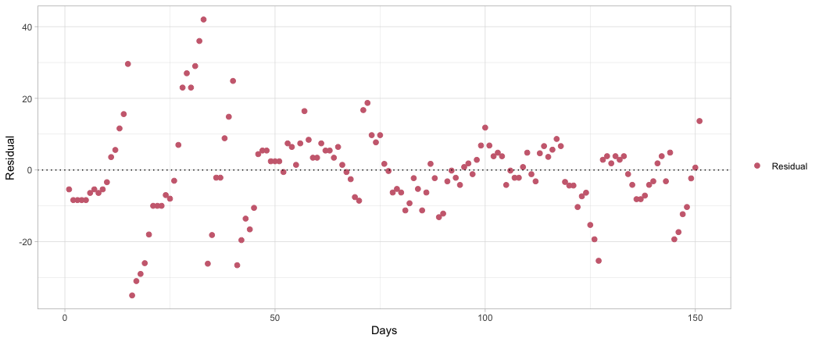
Regression Tree
The root-mean-squared-error was used to measure how far the predicted values are from the observed ones.
Model | RMSE
model trained with total patients hospitalized and total people tested cp equals to 0.0213 xval equals to 10 | 10.41

Slide 43
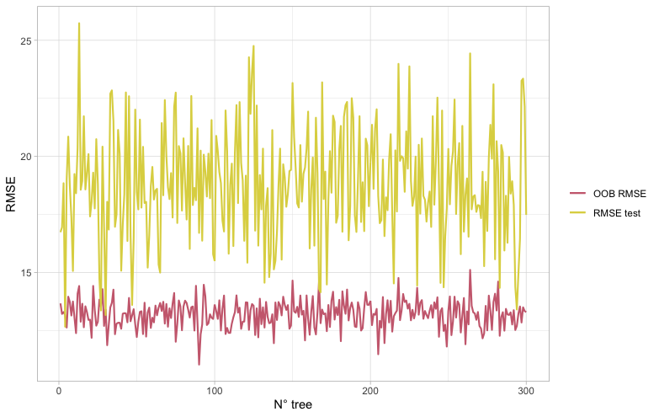
Bagging
To train the best bagging model, the number of trees parameter, was analyzed by training many times the model with different combinations of independent variables, to avoid possible collinearity problems.
Two indexes were analyzed:
OOB error: error on the unseen data during the training
RMSE: test error on the predicted values
From the plot we can see that the number of trees does not influence the OOB error and the RMSE. We can conclude that the bagging approach is not useful to solve this problem.

Slide 44
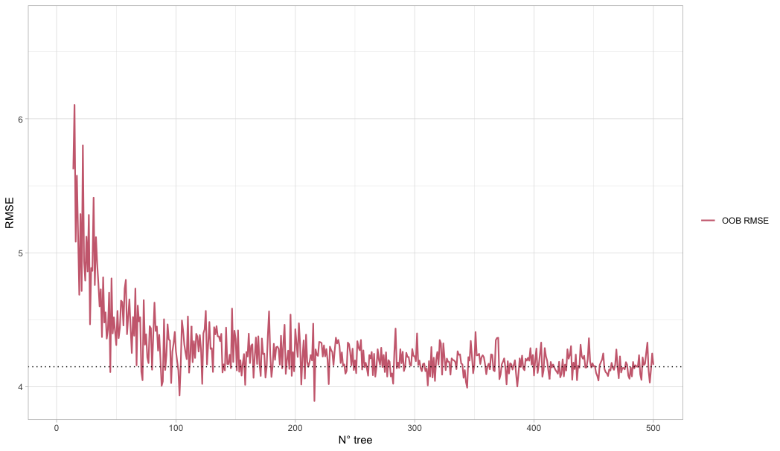
Random Forest
Also in this case the number of trees parameter, to train the best random forest model, was analyzed by training many times the model with all the covariants of the dataset since the random forest does not suffer of multicollinearity.
The index OOB error was analyzed to select the best number of trees for training the model. A value approximately equals to 100-150 was chose as the best number of trees.

Slide 45
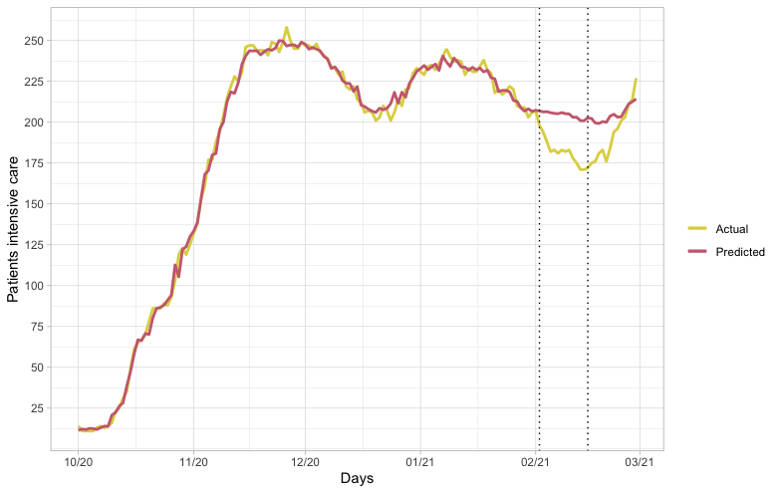
Random Forest
The prediction and the results were computed for the first 15 days of February. The trend then was analyzed for the whole month.
The training prediction was computed with the OOB data and it seems that this model is overfitting the data.

Slide 46
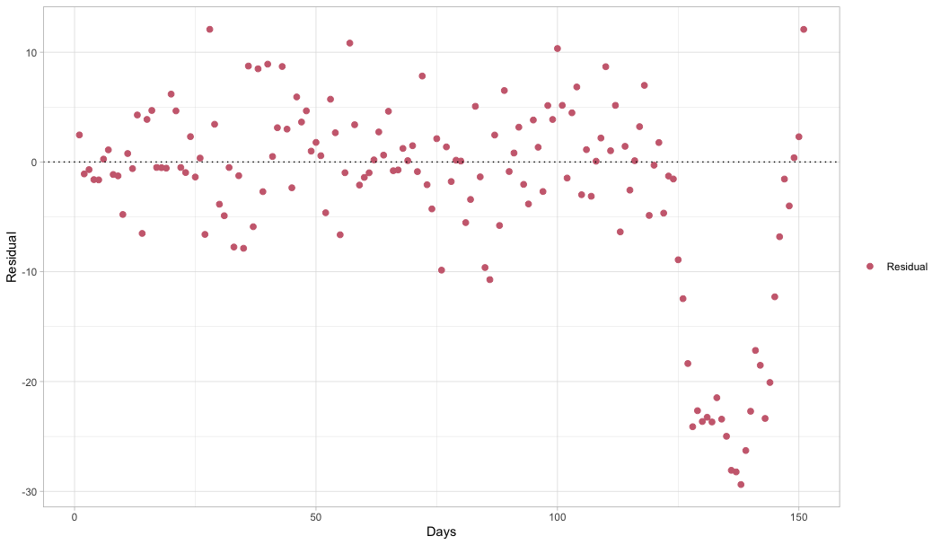
Random Forest
The root-mean-squared-error was used to measure how far predicted values are from observed ones.
Model | RMSE
model trained with all the covariants; number of trees equals to 150; mtry equals to root square of the number of covariants. | 19.58

Slide 47
Considerations
The single tree seems to be the best model in the prediction phase since it is generalizing appropriately the data. The problem is that since it is a simple tree it shows a trend composed by long steps.
The bagging ensemble method with these data is useless, since growing the tree is not affecting the error. This problem is maybe present because we have a dataset with not enough data.
The random forest approach shows a good trend increasing the number of trees since the OOB is decreasing, but in the prediction phase it was not accurate. It seems that random forest is poor at working on these data.

Slide 48
Conclusion

Slide 49
Root Mean Square Error
Approach | RMSE
LM | 19.22978
GLM | 12.63281
GAM | 3.73646199
Tree | 10.41
RF | 19.58
From the following table, we can conclude that the GAMs model has the lowest RMSE.

Slide 50
THANK YOU

